Slide 1
Assignment 1 - Requirements
by TA Sam Wang
112-2

Slide 2
About TA
王新翌 Sam
Contact me
Email: b10915033@gapps.ntust.edu.tw
Line: samwang009
Notes:
★: 放上戰機、血條和寶物。
血量: 50%
寶物位置隨機指定
★: 為作業加上註解，並標註與作業要求有關的程式碼
★: 變數名稱要能適切代表其意義，並使用 camelCase 方式命名
★★:放上敵機由左向右重複飛行。敵機完全移出右方螢幕後，從左方重新開始飛行。
★★★: 放上背景，並向右無限捲動

Slide 3
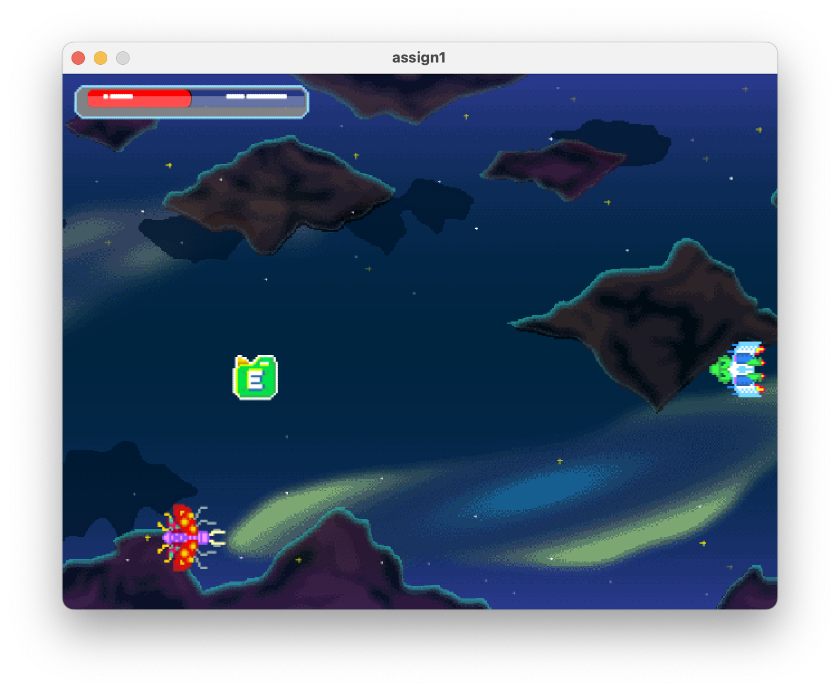
Assignment 1 – part 1/2
Fork assignment here.
Commit your code directly to GitHub
Due: 3/17 12 p.m.
Grading rubric:
C: Completing all 1-star requirements.
B: Completing all 1-star and 2-star requirements.
A: Completing all requirements (1-star, 2-star, and 3-star)
Notes:
★: 放上戰機、血條和寶物。
血量: 50%
寶物位置隨機指定
★: 為作業加上註解，並標註與作業要求有關的程式碼
★: 變數名稱要能適切代表其意義，並使用 camelCase 方式命名
★★:放上敵機由左向右重複飛行。敵機完全移出右方螢幕後，從左方重新開始飛行。
★★★: 放上背景，並向右無限捲動

Slide 4
Assignment 1 – part 2/2
Requirements：
1-star
Add a spaceship to the right-center of the screen.
Add a health bar to the left-top corner of the screen at position (10, 10).
Show the player's health using a red bar that fills up to 50%.
Add a treasure to a randomly generated position on the screen.
Add comments and label the code related to the requirements.
Variable names should be able to properly represent their meaning and be named using camelCase.
2-star
Place an enemy aircraft that flies repeatedly from left to right.
After the enemy aircraft completely exits the right side of the screen, it restarts flying from the left side.
3-star
Add a background and scroll it infinitely to the right
Notes:
★: 放上戰機(靠右中)、血條和寶物。
血量: 50%
寶物位置隨機指定
★: 為作業加上註解，並標註與作業要求有關的程式碼
★: 變數名稱要能適切代表其意義，並使用 camelCase 方式命名
★★:放上敵機由左向右重複飛行。敵機完全移出右方螢幕後，從左方重新開始飛行。
★★★: 放上背景，並向右無限捲動

Slide 5





Hint
hpBar
enemy
fighter
treasure
bg1
bg2
* Use the modulo operator to achieve the infinite scrolling effect

Slide 6
GitHub Tutorial
by TA Sam Wang
112-2

Slide 7

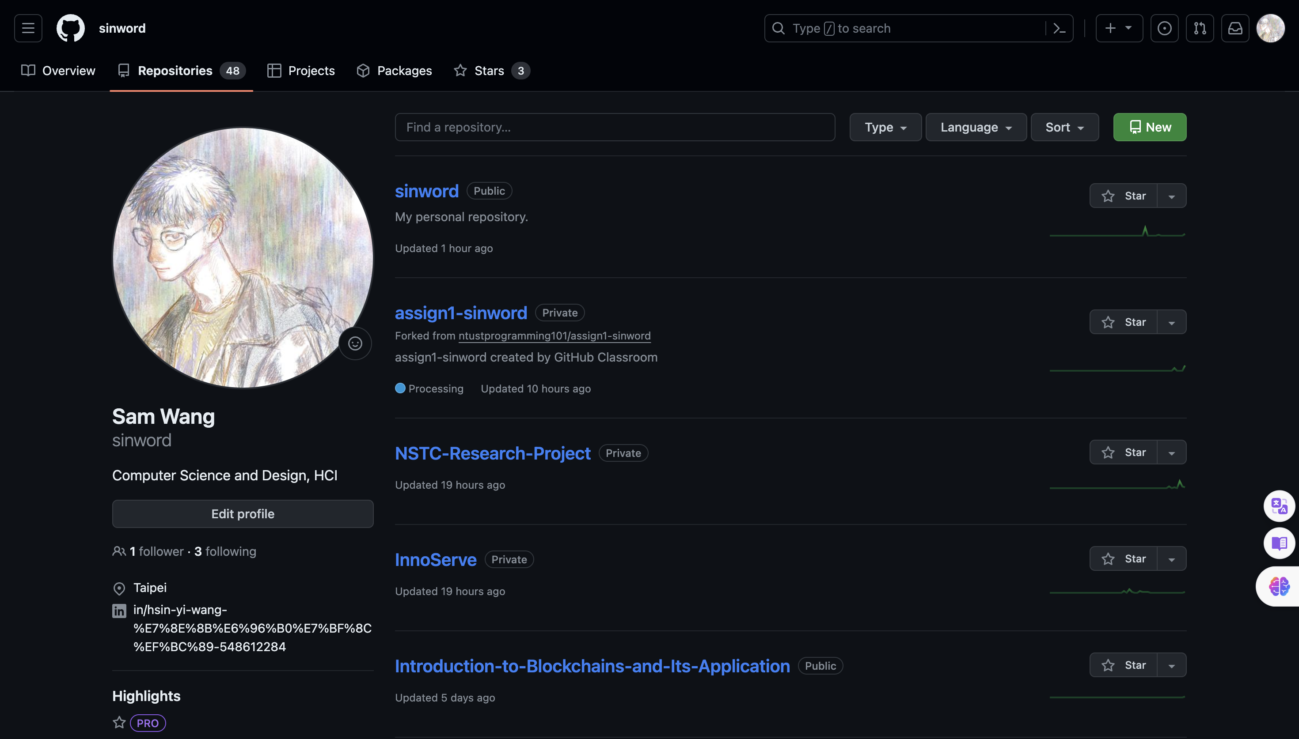
What is GitHub ?
GitHub is a code hosting platform for…
Version control
Collaboration
It can be seen as Google Drive for code and development.

Slide 8
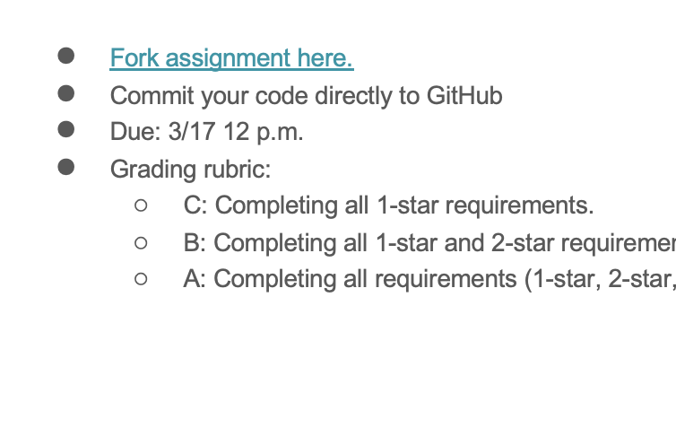
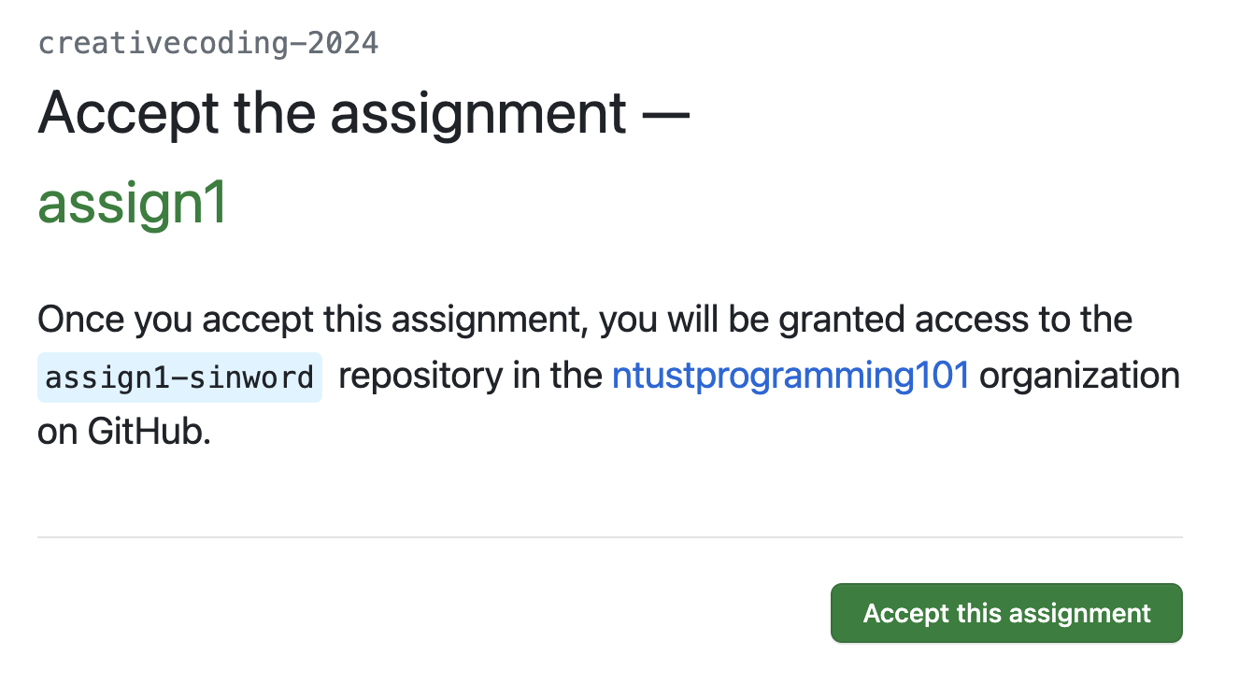
Accept Assignment on GitHub (You have to register first)

Slide 9
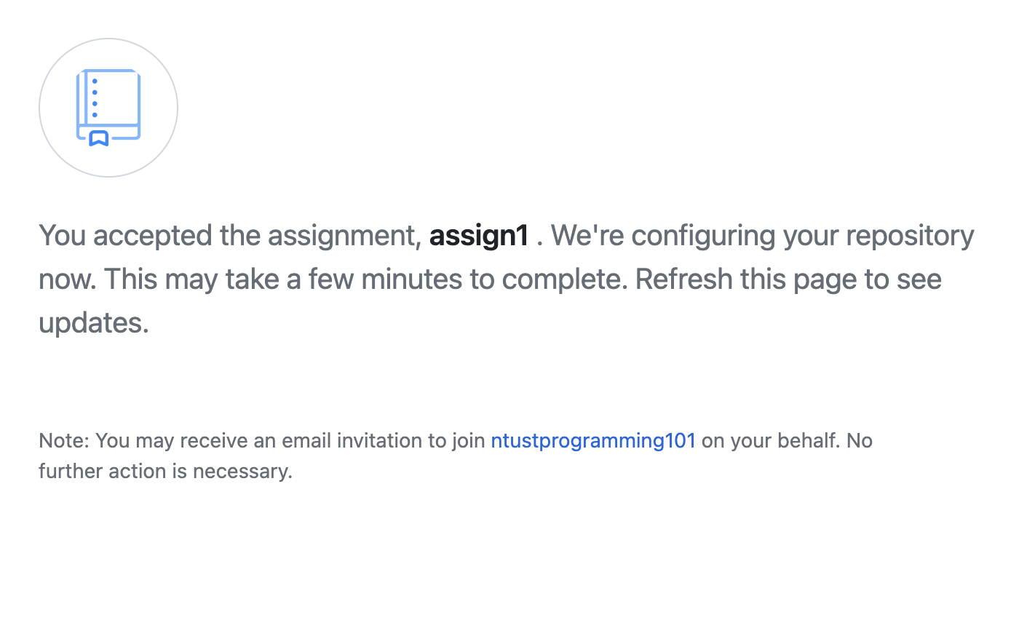
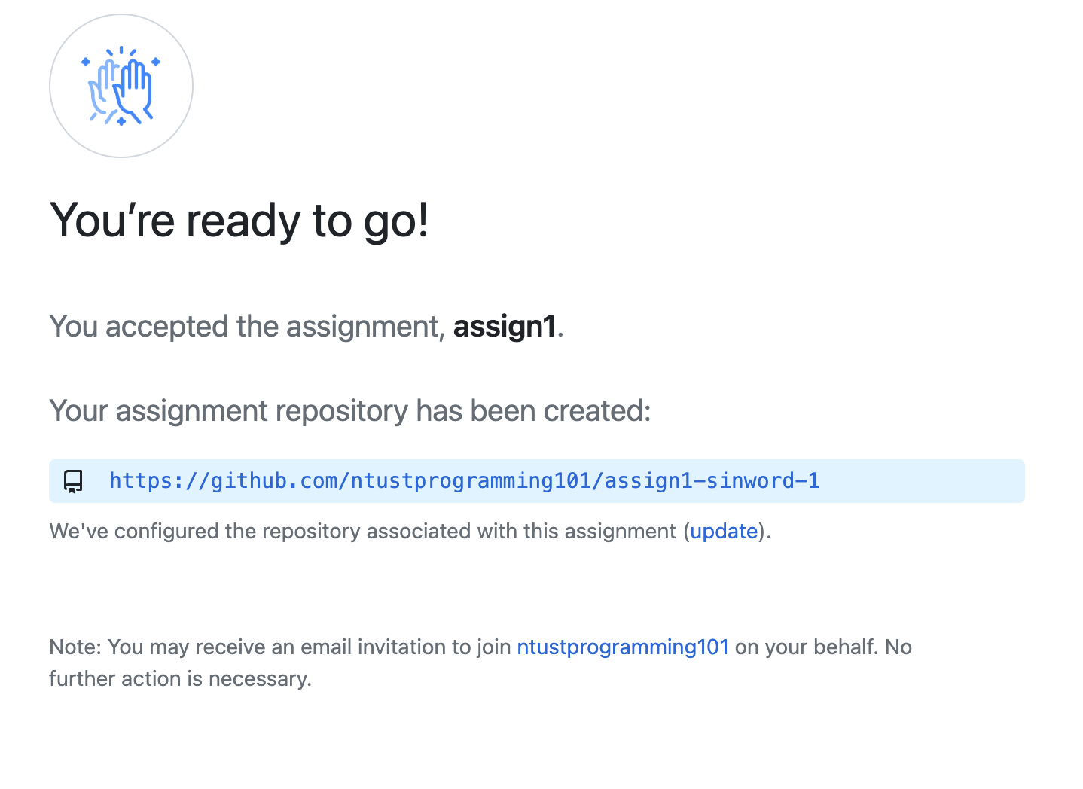
Accept Assignment on GitHub
refresh

Slide 10
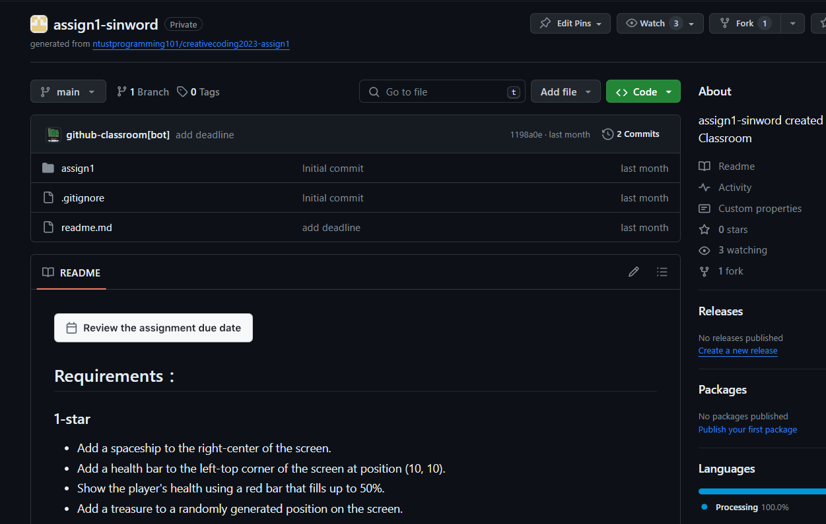
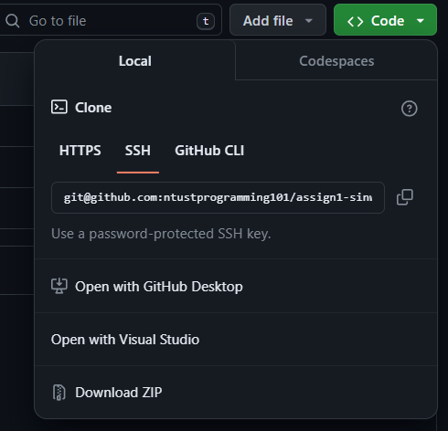
Get Your Assignment Link!
you can also find the link here

Slide 11
Two Approaches to Edit Your Code on GitHub
GitHub
Desktop
Local Editor
GitHub
Online Website

Slide 12

Download GitHub Desktop
https://desktop.github.com/

Slide 13

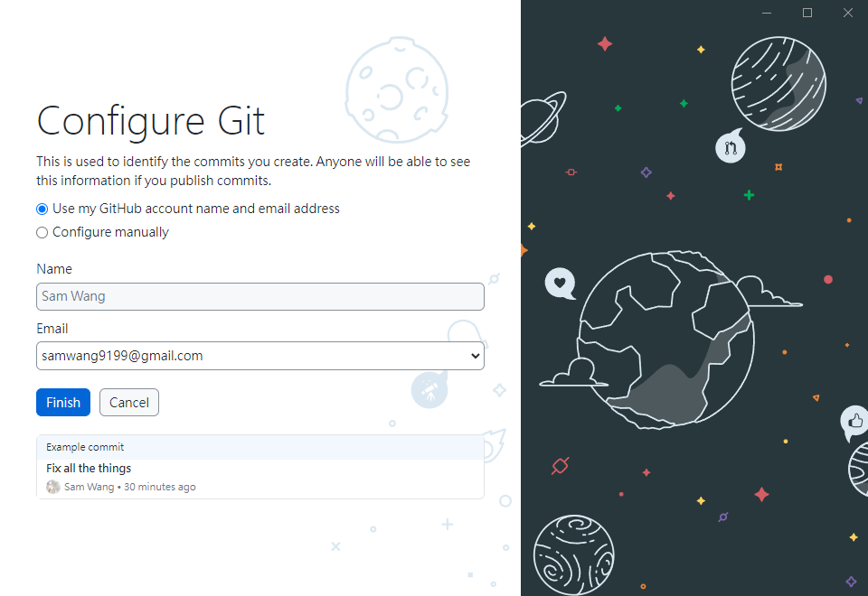
Install & Authenticate

Slide 14
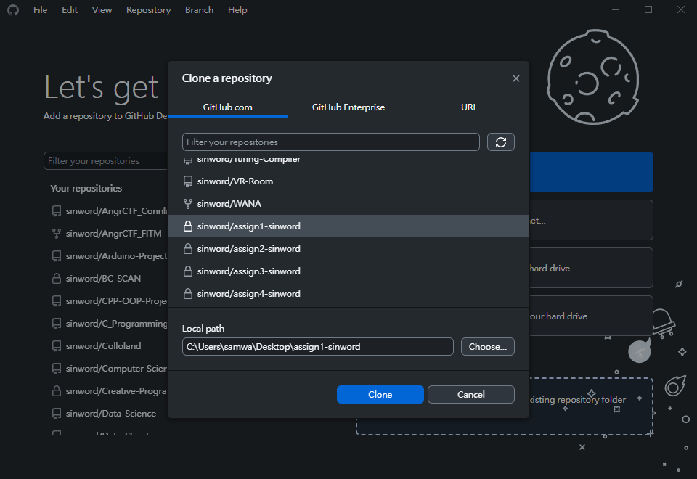
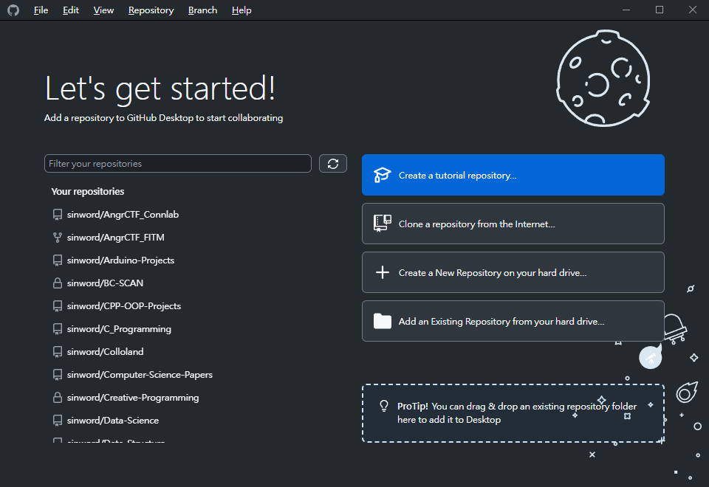
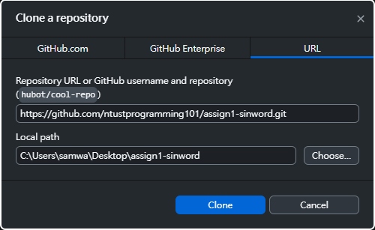
How to Clone Your Project?
(1)
OR
(2)
Notes:
clone的意思

Slide 15
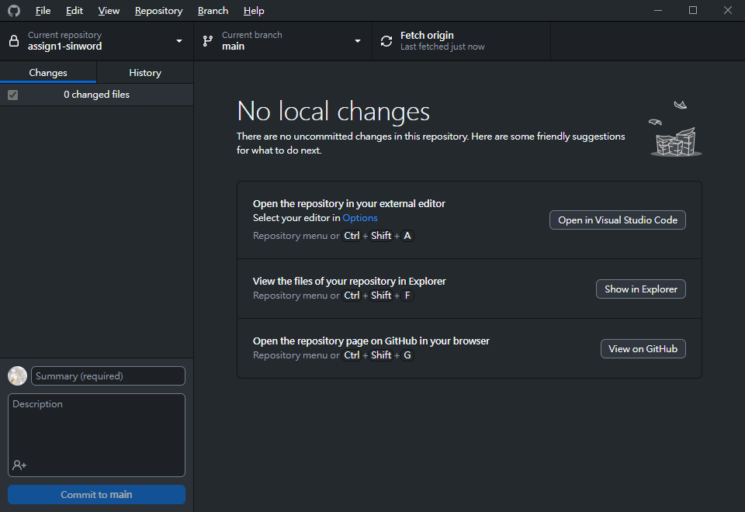
How to Clone Your Project?

Slide 16
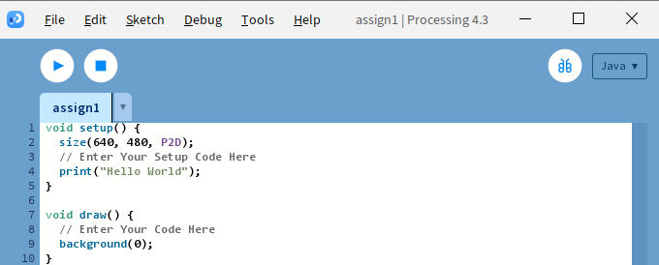
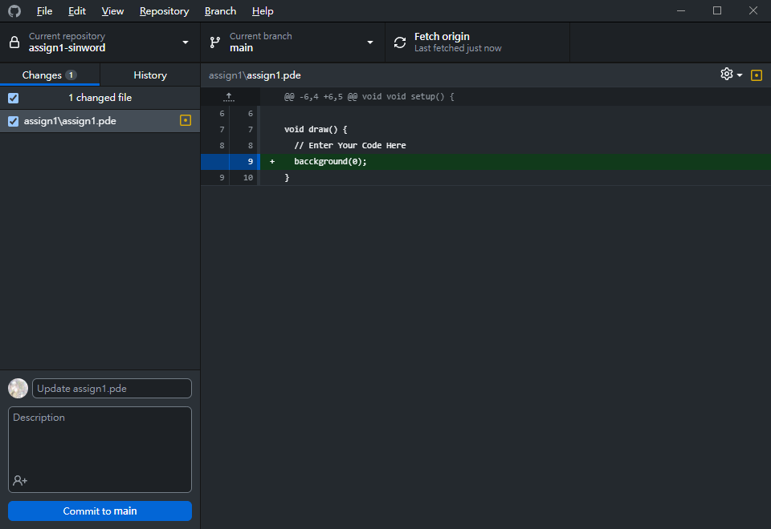
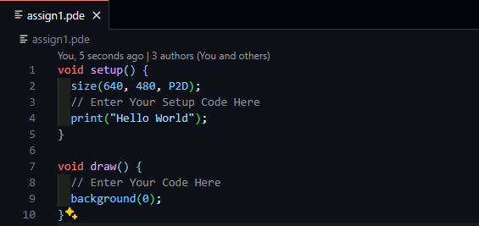
How to Edit in the GitHub Desktop?

Slide 17
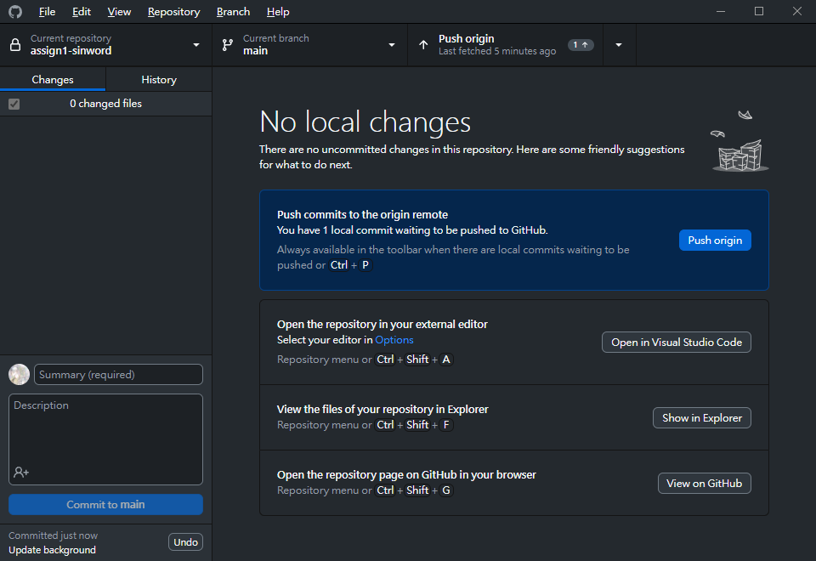
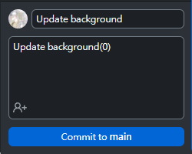
How to Upload My Code to GitHub?

Slide 18
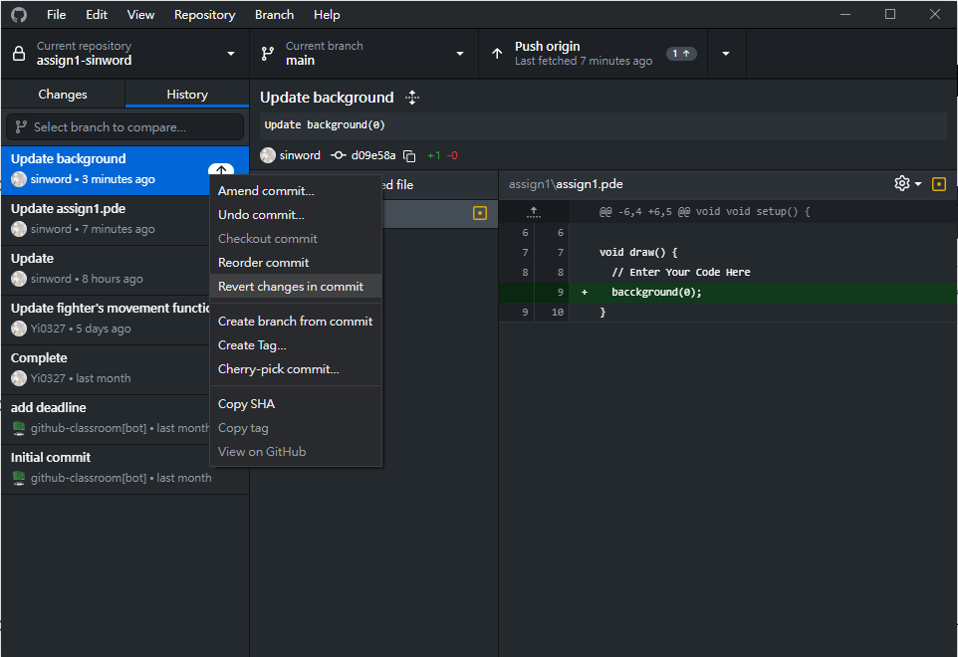
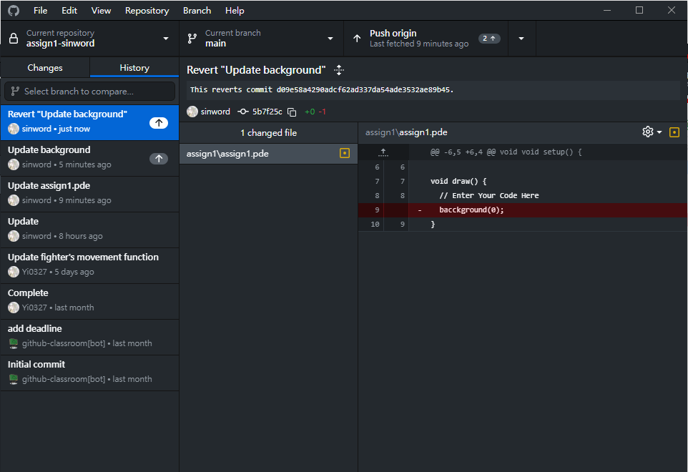
What if I Change My Mind? >> Version Control in GitHub

Slide 19
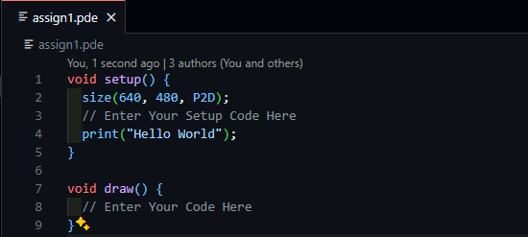
What if I Change My Mind? >> Version Control in GitHub
After Reverting

Slide 20
GitHub
Desktop
Local Editor
GitHub
Online Website
You can also edit directly online!

Slide 21
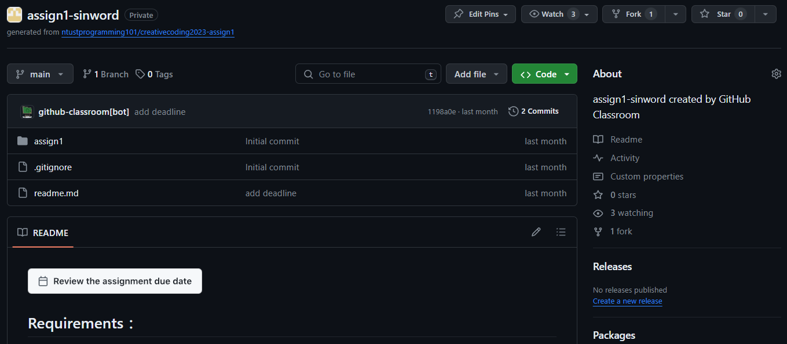
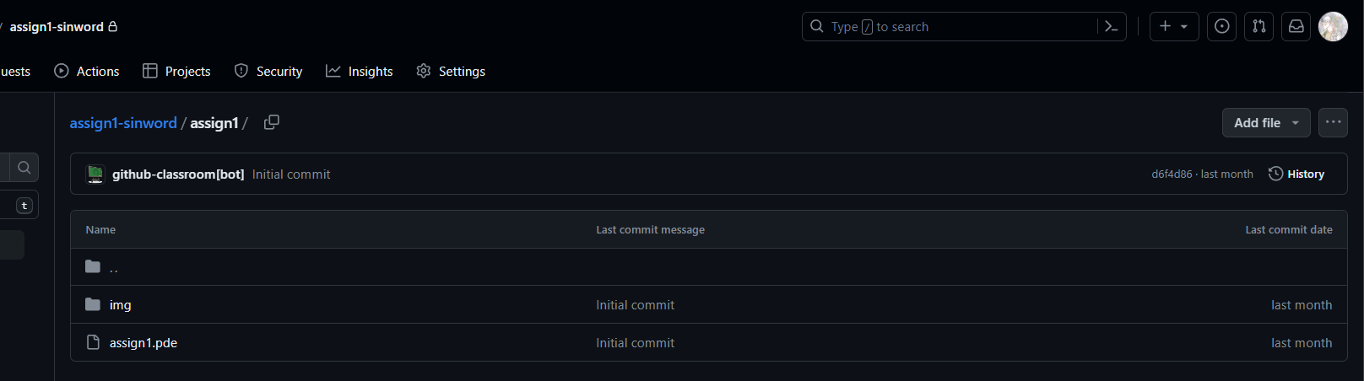
Edit your code to the file directly on the GitHub website
1.
2.

Slide 22
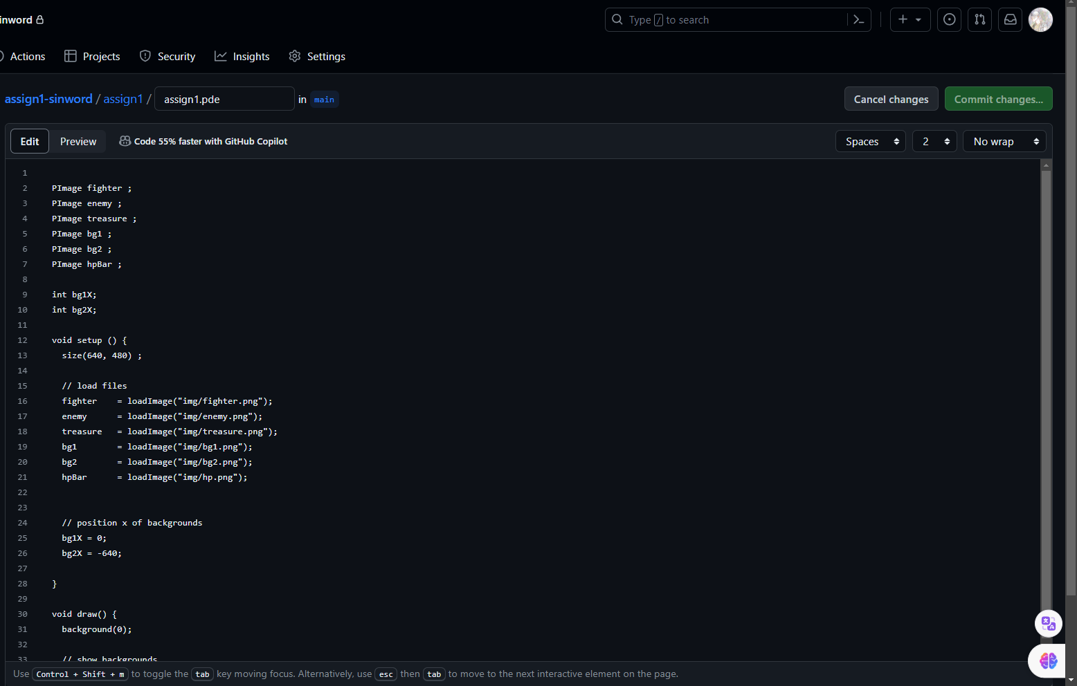
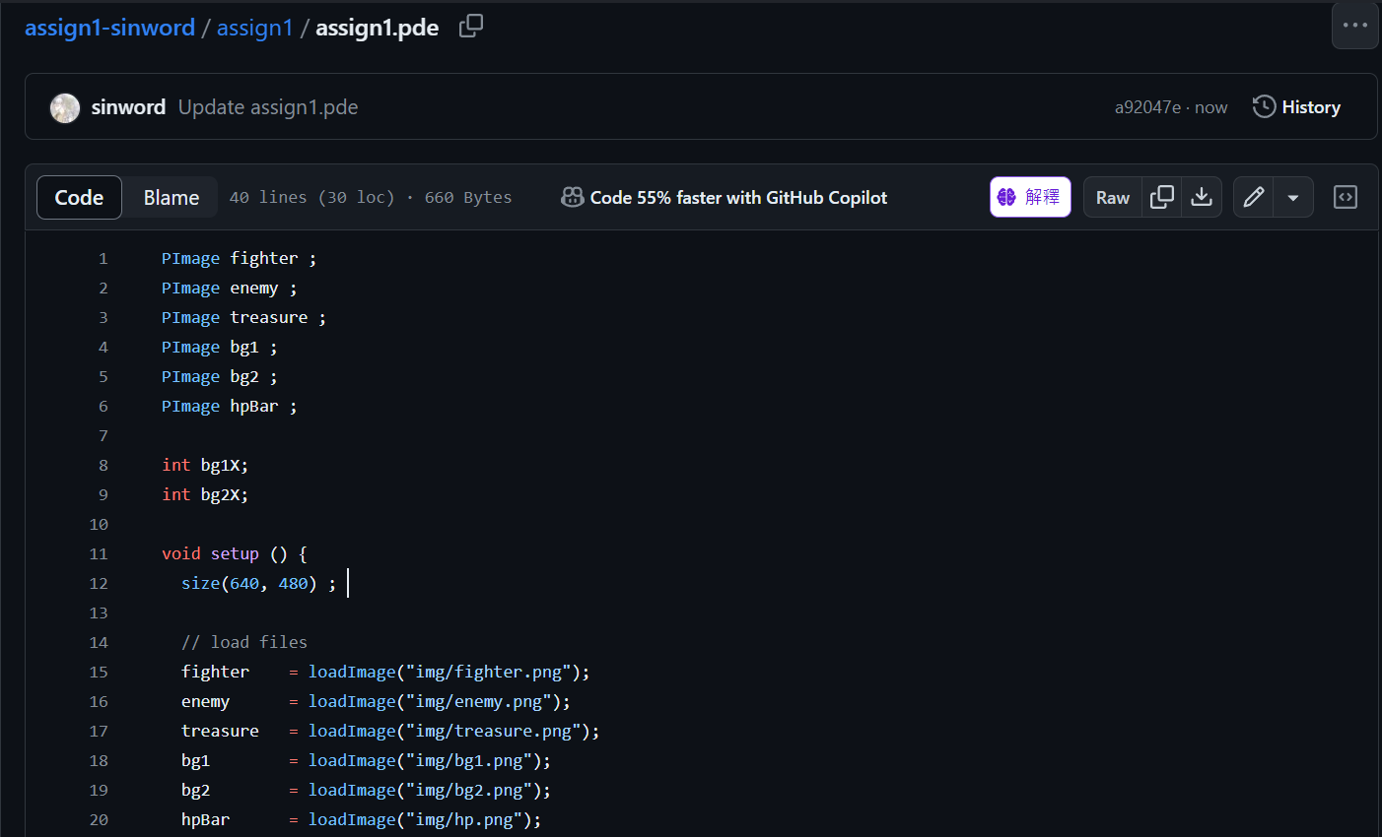
Edit Your Code Directly on the GitHub Website
4. Edit your code in this area
3.

Slide 23
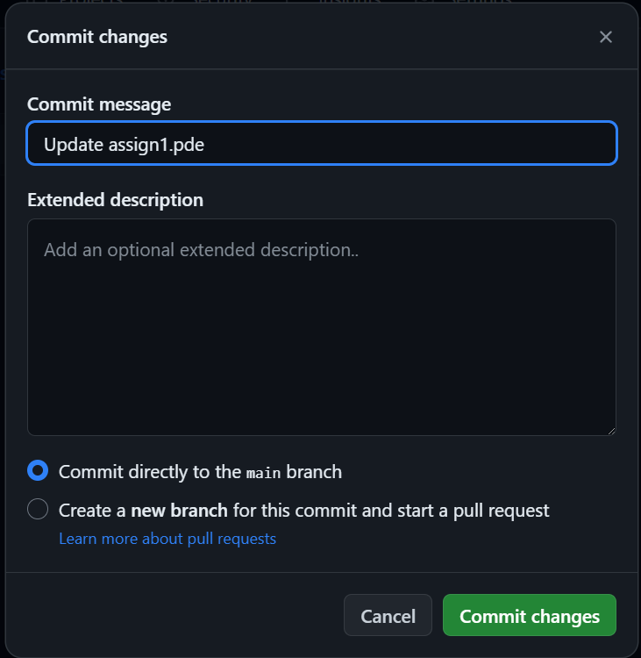
Remember to Create Comment and Commit Changes

Slide 24
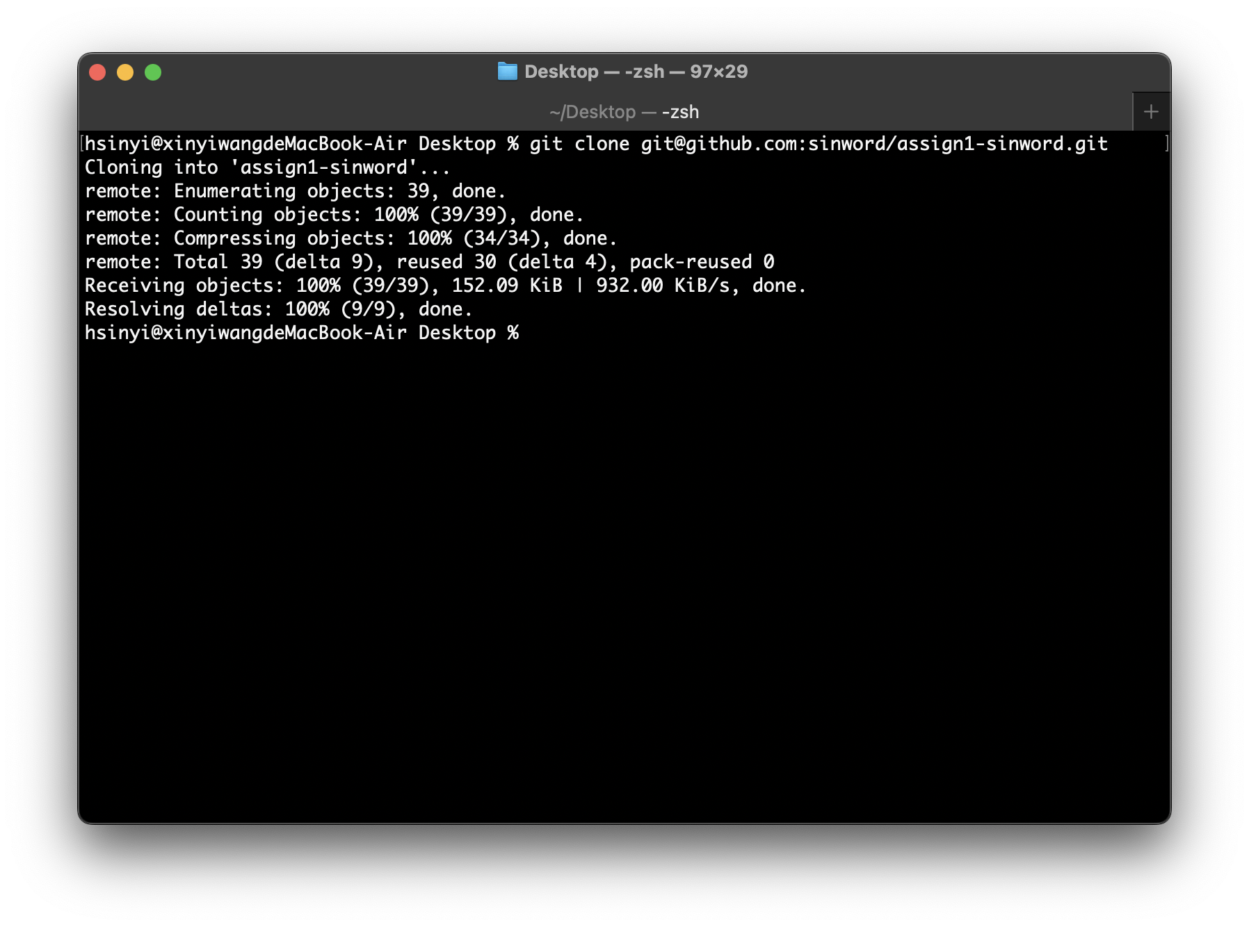
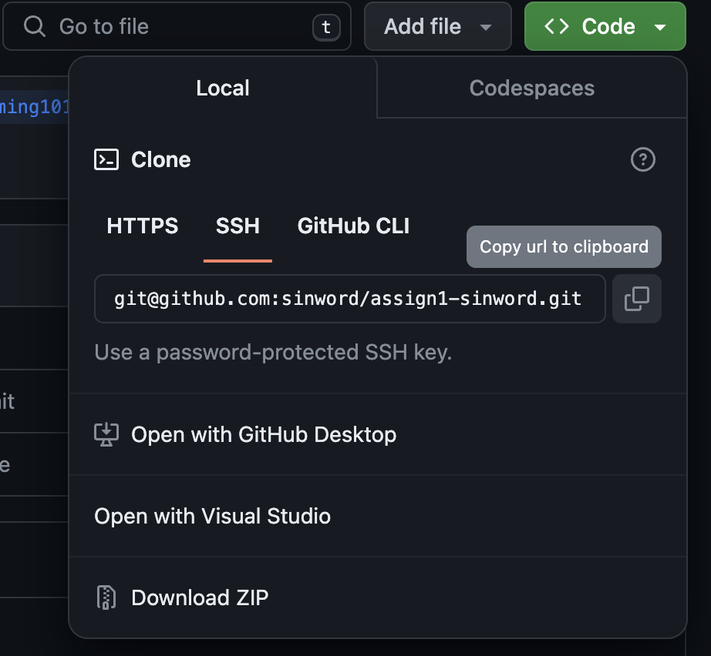
My Approach
2. Enter command in terminal
git clone “url”
1. Copy SSH url

Slide 25
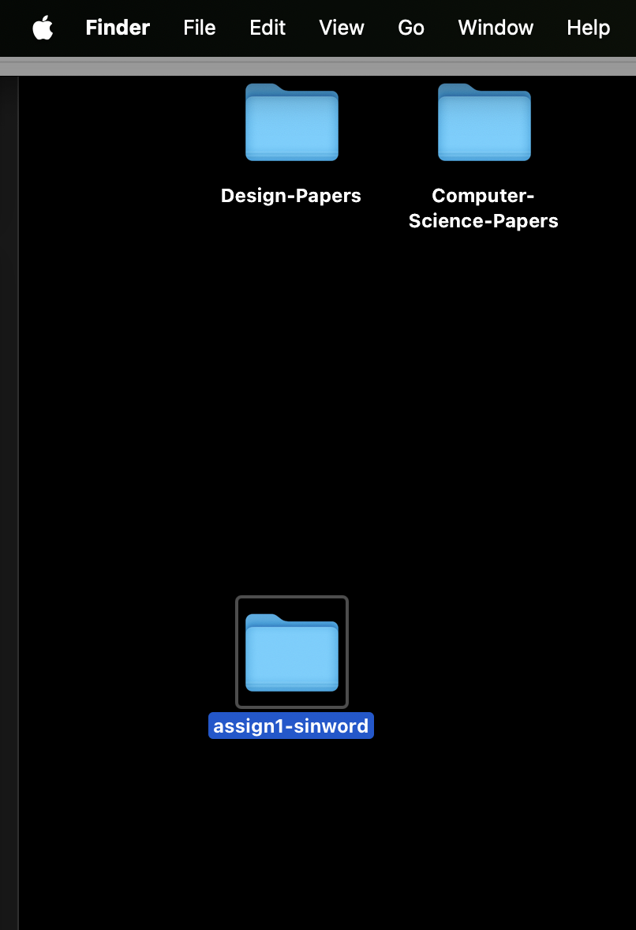
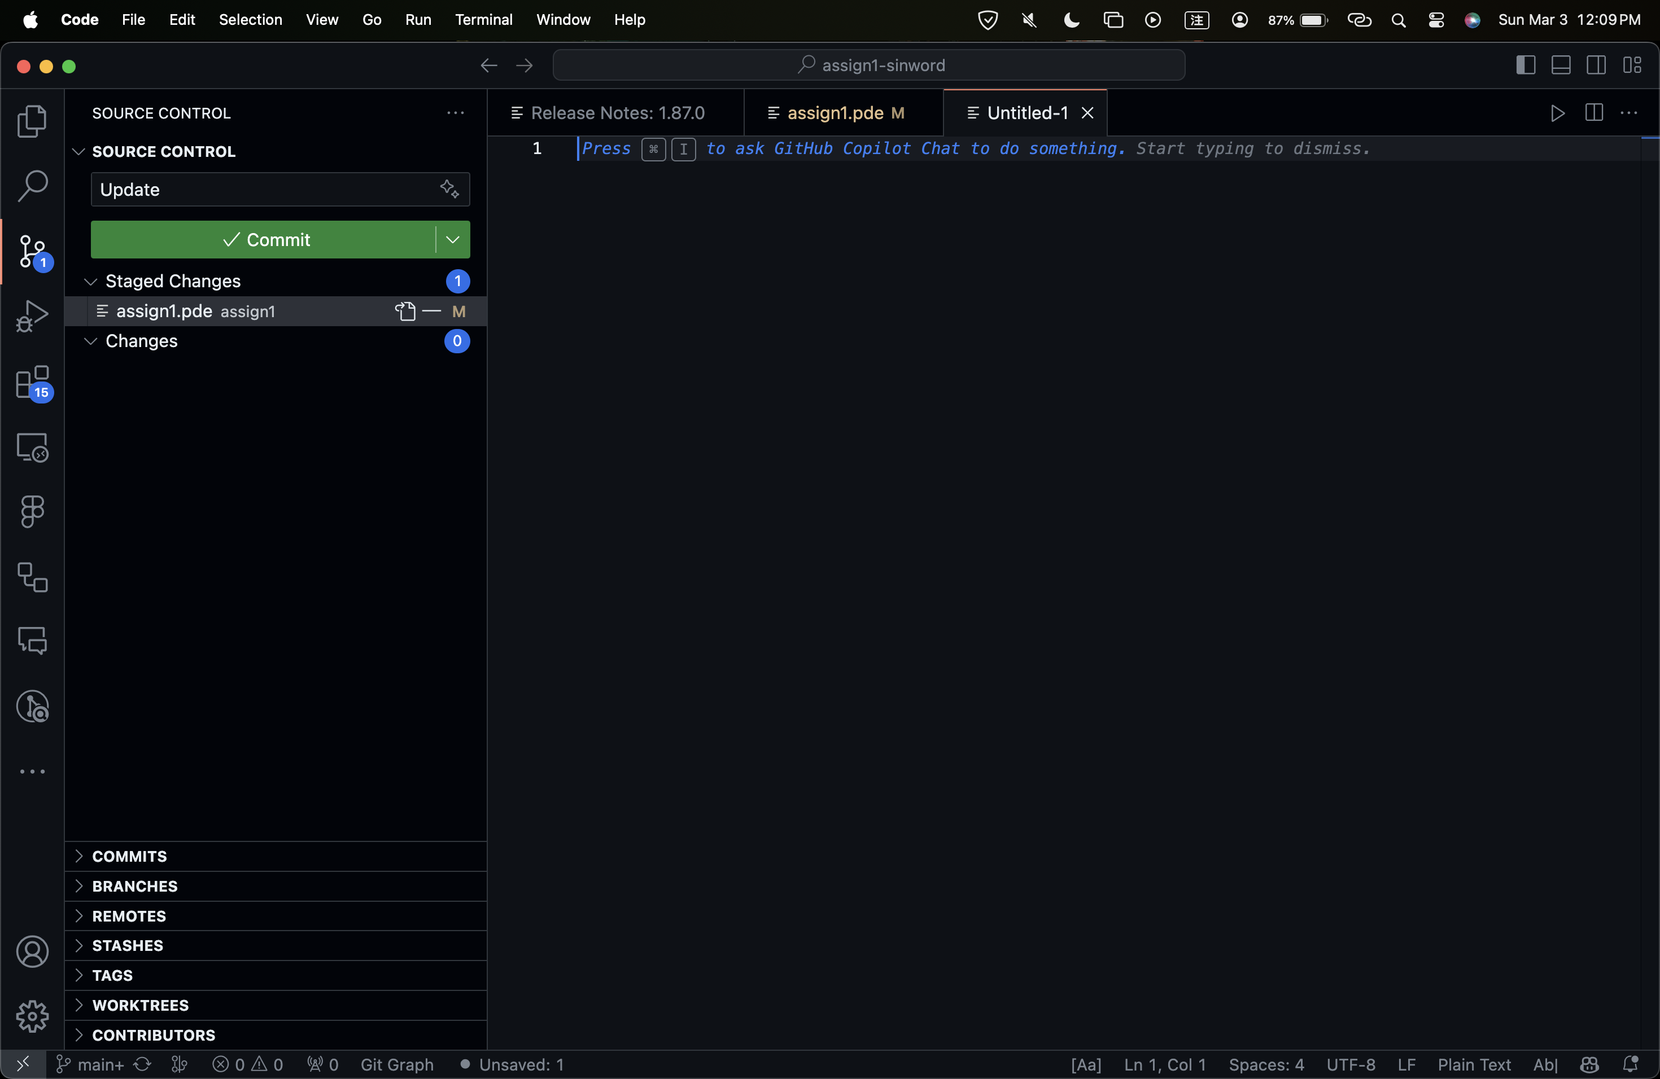
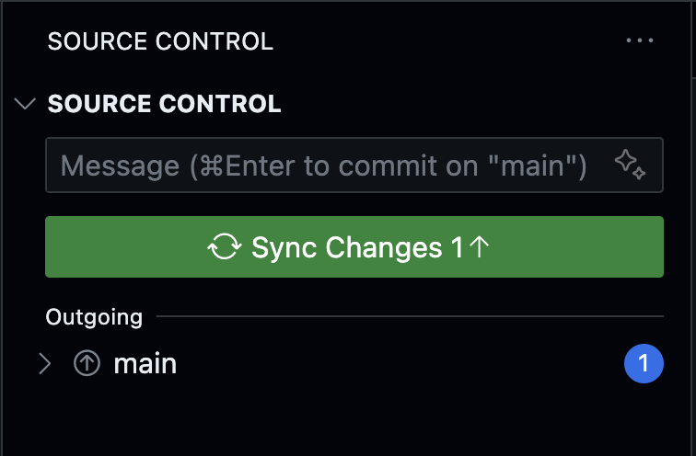
My Approach
4. Write down the commit message in VSCode and click “Commit"
3. The folder shows under the directory
5. Click “Sync Change”

Slide 26
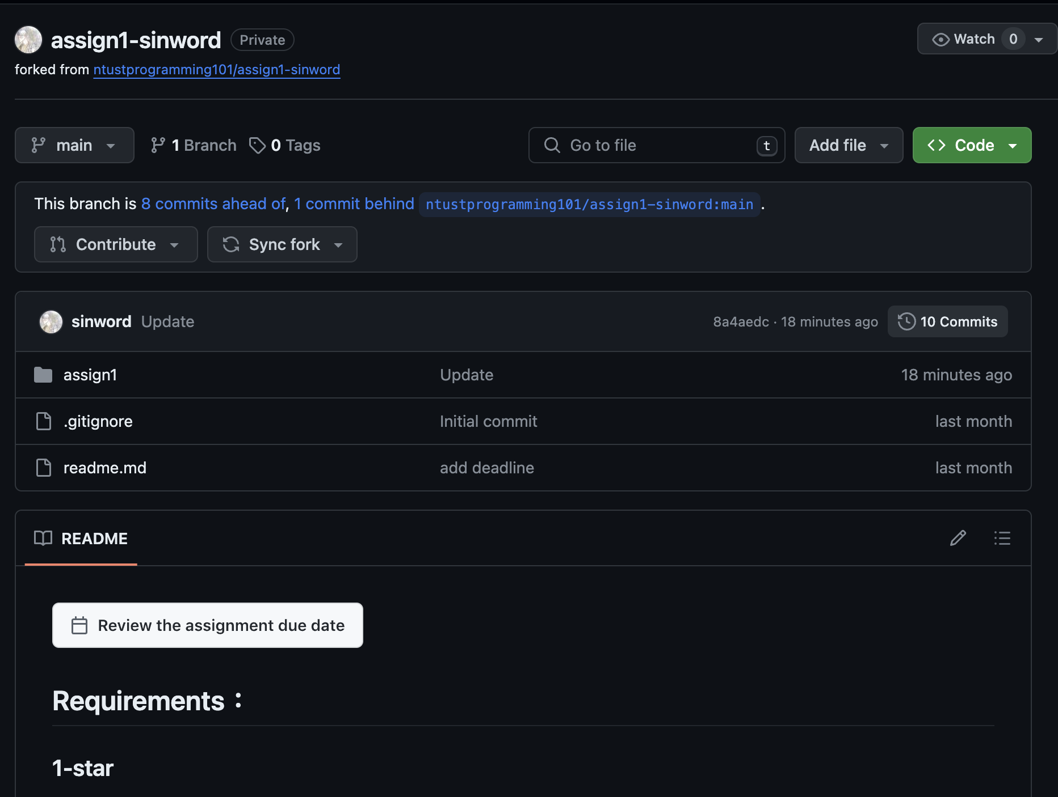
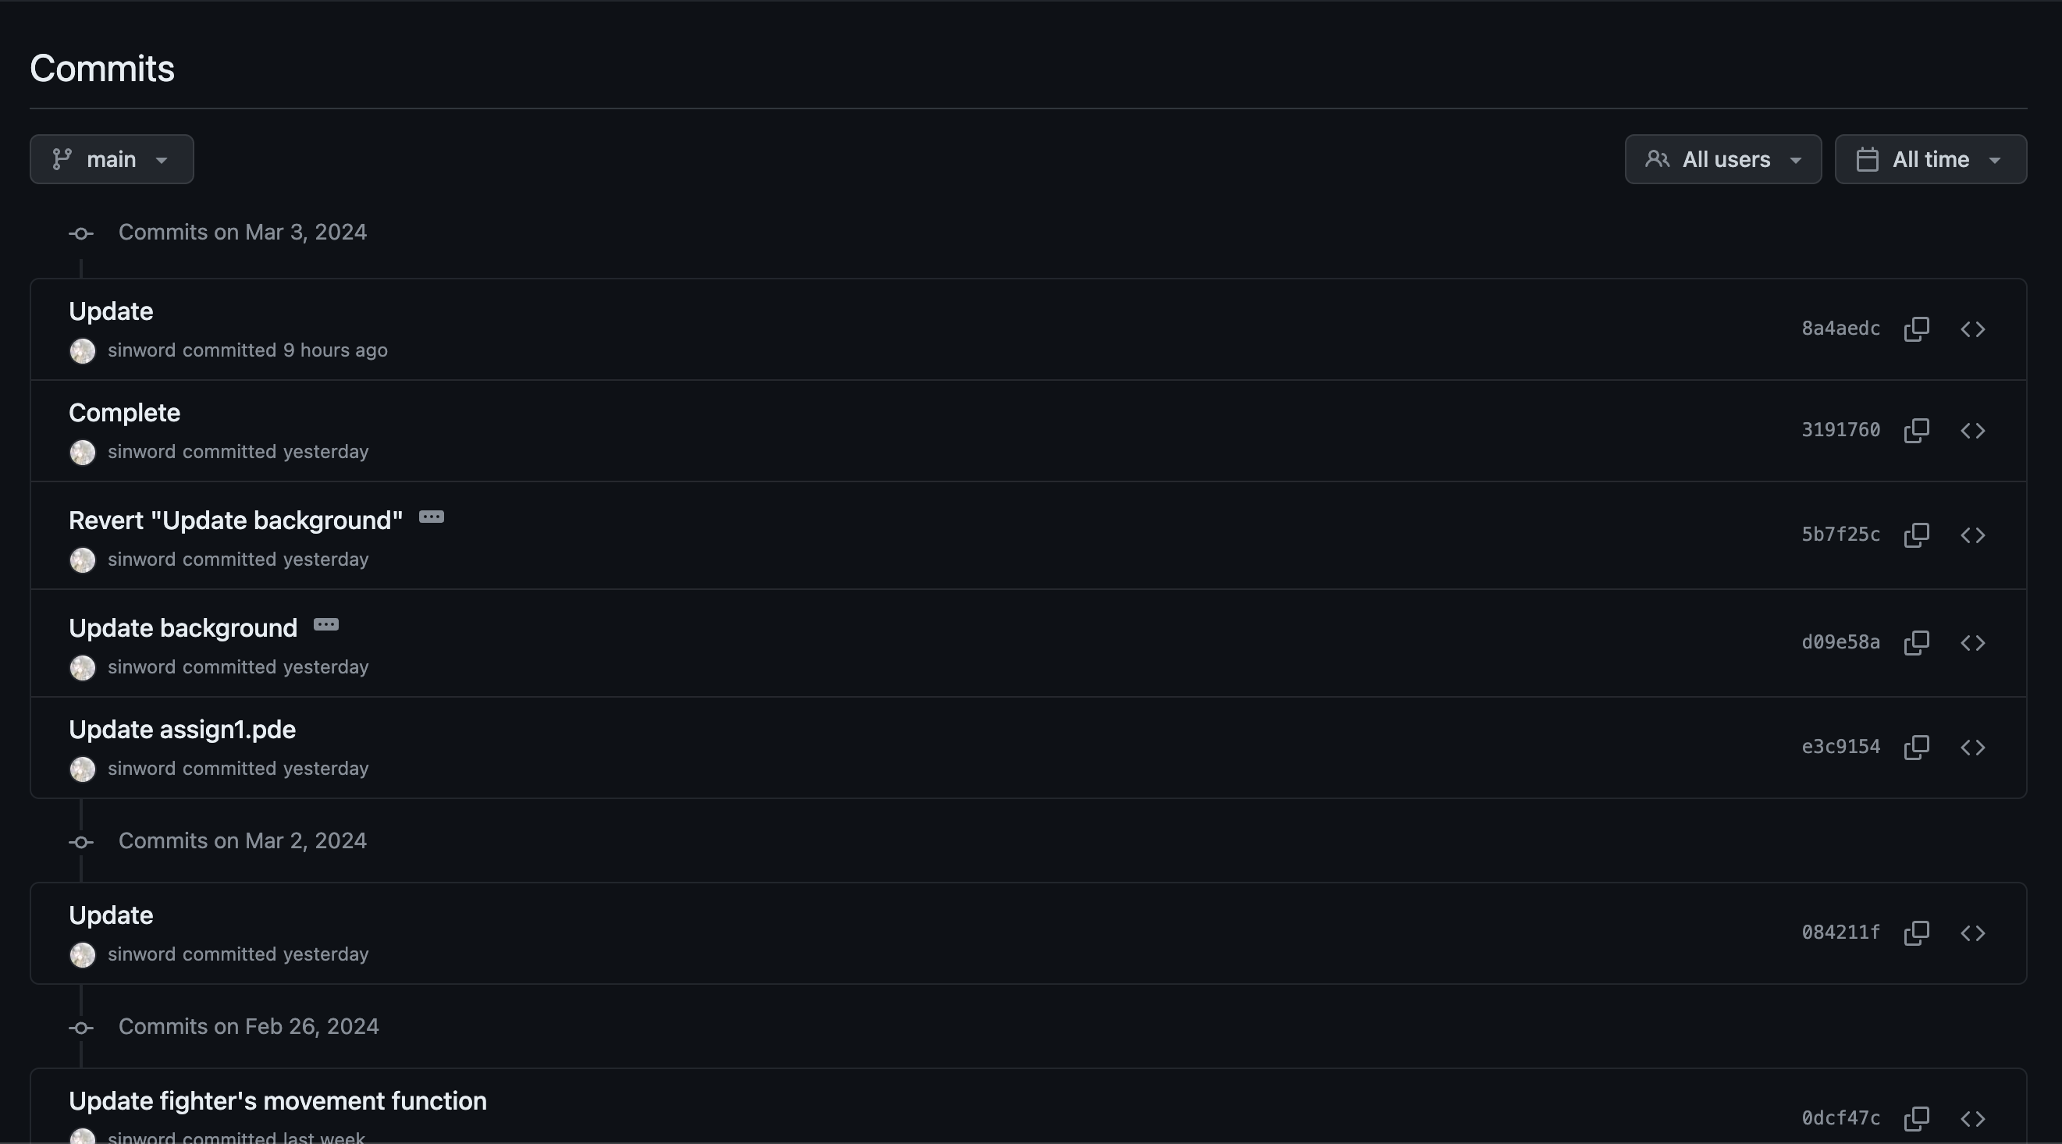
Check Your Commits
History commit will be shown here
Or check on GitHub Desktop

Slide 27

About AI…
They are great teachers for beginner!
It can be used in learning, coding, translating, and more.
Do not rely too heavily on AI, or someday you may find yourself replaced by it.

Slide 28
Reference
Get started with Github (Official document): https://dorcs.github.com/en/get-started/quickstart/hello-world
How to use Github Desktop (Chinese) : https://progressbar.tw/posts/49
連猴子都能懂的git入門指南 : https://backlog.com/git-tutorial/tw

